Slide 1
How to chain bash commands

Slide 2
You have to review
file descriptor table
dup
dup2
pipe
fork (both memory and page descriptor tables will be duplicated)
execl

Slide 3
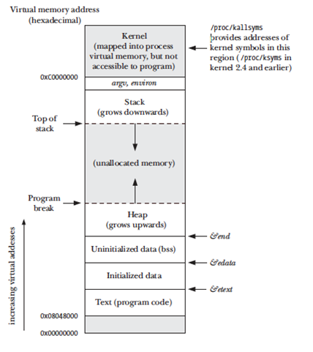
Memory layout of a Process

Slide 4
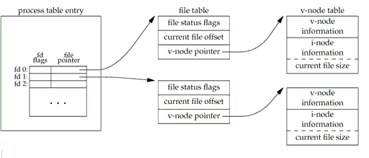
file descriptor

Slide 5
Standard Input output error streams
STDIN_FILENO
STDOUT_FILENO
STDERR_FILENO

Slide 6
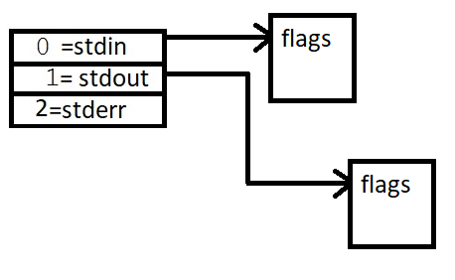
When you launch a program, the page descriptor table looks like this

Slide 7
Let us see the example : ls | wc -l

Slide 8
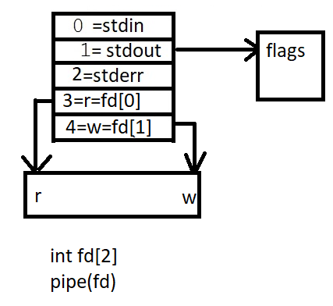

Slide 9
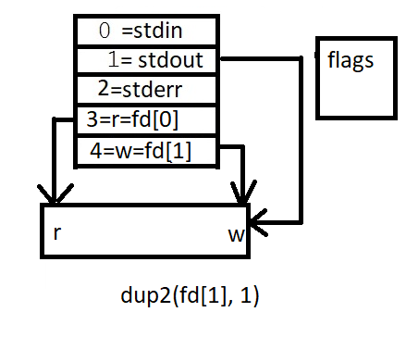

Slide 10
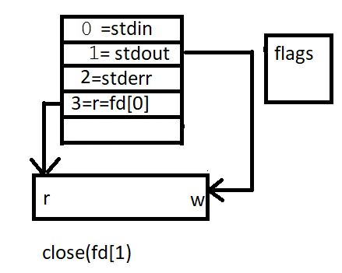

Slide 11
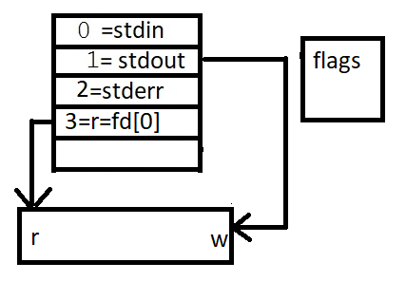
restoreFd = fd[0]

Slide 12
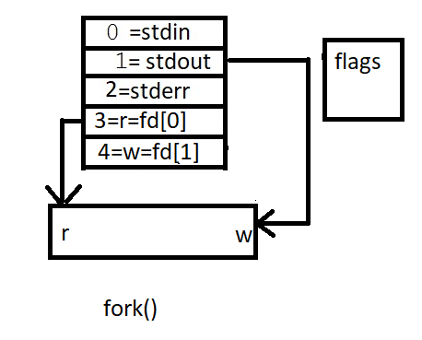
child will execute (say ls printing in the pipe)

Slide 13
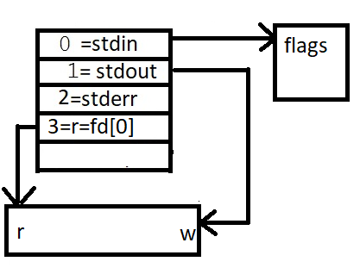
back to parent

Slide 14
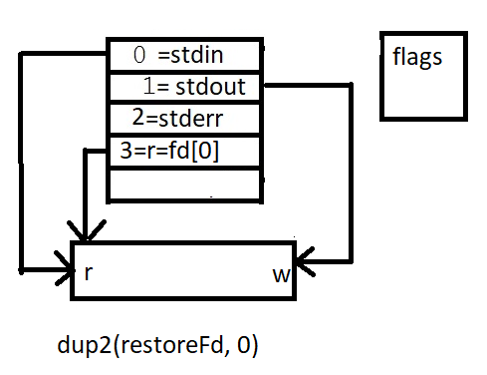

Slide 15
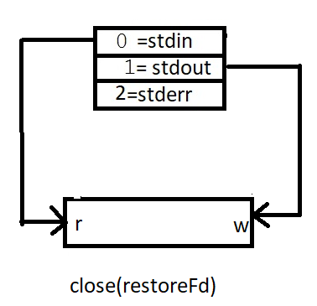

Slide 16
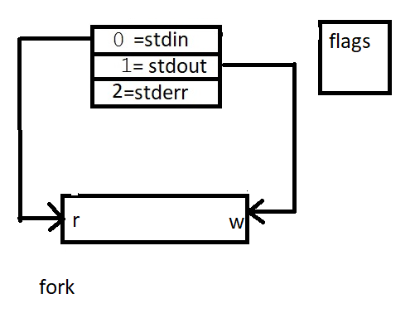

Slide 17
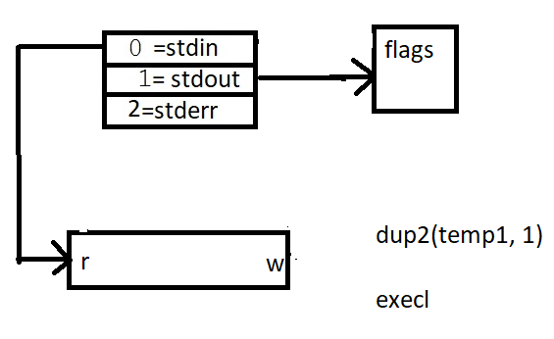
Will execute WC

